Slide 1
Welcome to Birch Wood School
EYFS Curriculum
At Birchwood we want to provide an enabling environment which engages and inspires pupils to develop Characteristics Of Effective Learning that will last a life time

Slide 2
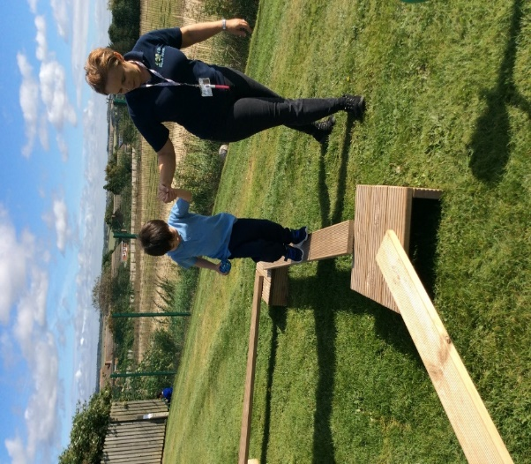
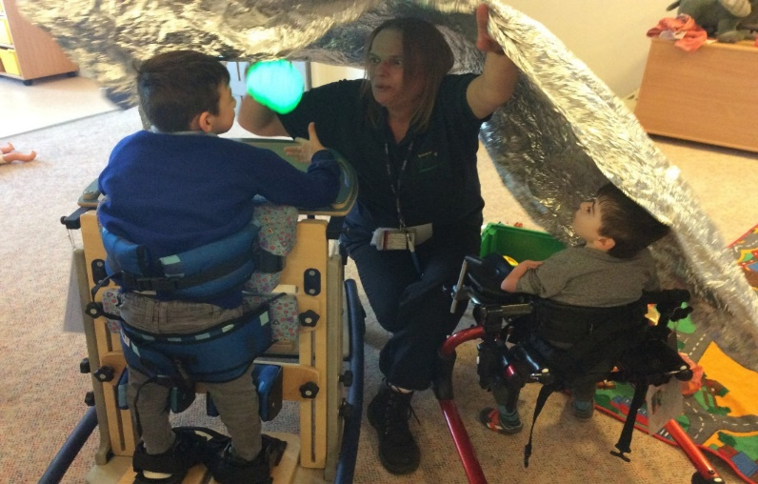
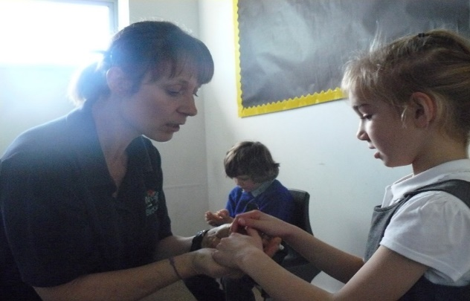
Guiding Principles
We recognise in the Early years that children are ‘learning to learn’ and need opportunities to develop foundational skills within a nurturing environment.
These Principles interact with and reflect Birch Wood’s child centred approach to learning, which incorporates each child’s Education Health Care Plan

Slide 3
Guiding Principles Implemented
A UNIQUE CHILD – developing resilient, capable, confident and self-assured individuals.
Time spent with each child (Transition)
Able to cope with changes. Prepare children for change, use symbols, build in change
Allow for independence – Dressing and changing routines, eating and drinking. Backward chaining
Opportunities to problem solve – Ask open questions, prompt thinking skils, what happens if?
POSITIVE RELATIONSHIPS– supporting the children in becoming strong and independent.
Key person in term one
Focus on communication and interaction (hello sessions, songs, games and play),
Feedback and positive behavior support
Facilitate independent learning (e.g. independence boxes, starting and finishing)
ENABLING ENVIRONMENTS– where opportunities and experiences respond to the individual needs of the child by developing a strong partnership between practitioners, parents/carers and the child.
Transition e.g. working with parent/nursery to ease anxiety (use of objects, social stories)
Total Communication Environment
Stimulating resources
LEARNING AND DEVELOPING– An acknowledgement that children learn in different ways and at different rates

Slide 4
Three characteristics of effective learning
• Playing and exploring – Engagement
Children investigate and experience things, and ‘have a go’
• Active learning – Motivation
Children concentrate and keep on trying if they encounter difficulties, and enjoy achievements
• Creating and thinking critically
Children have and develop their own ideas, make links between ideas, and develop strategies for doing things.

Slide 5
Characteristics of effective learning Implemented
Playing and exploring – Engagement Children investigate and experience things, and ‘have a go’
Children’s interests and play schemas are encouraged, explored and extended (alongside themes) to increase engagement
Adults engage children at their own level, using strategies such as intensive interaction to engage children in shared attention
Small steps are encouraged and celebrated
Play is modelled
Activities are delivered in short bursts

Slide 6
Active learning – Motivation Children concentrate and keep on trying if they encounter difficulties, and enjoy achievements
Activities and learning behaviors are modelled through the day
Praise is specific focusing on effort
Activities are planned to meet children’s needs including sensory
Lesson activities are tactile and allow for children to engage in a hands on way
Creating and thinking critically
Open ended resources which allow for children to develop their own ideas
Testing things out, prompted by adults e.g. what happens if?
Tasks and routines broken down into parts to allow logical and sequential thinking

Slide 7
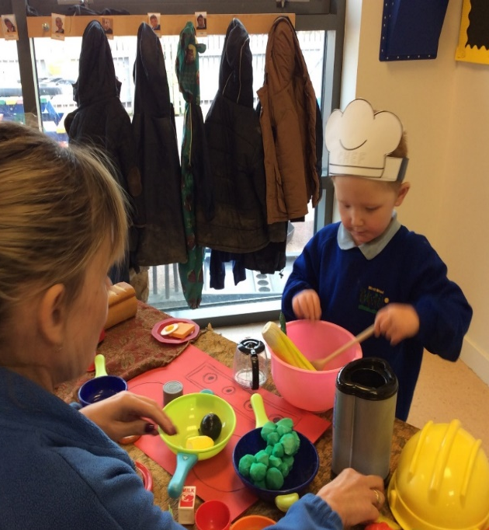
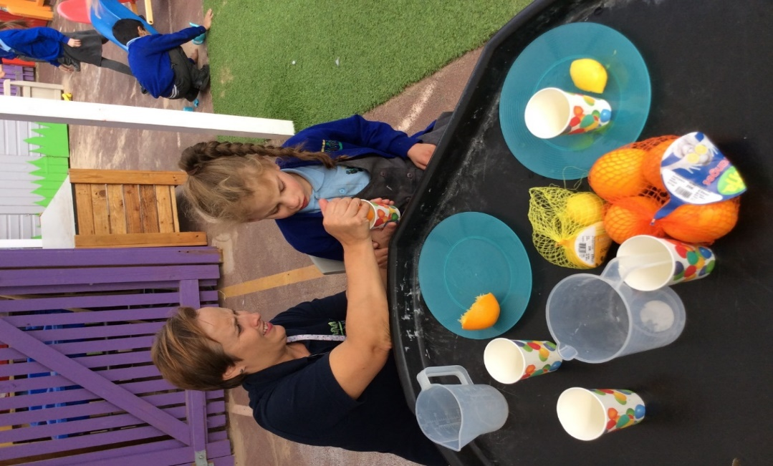
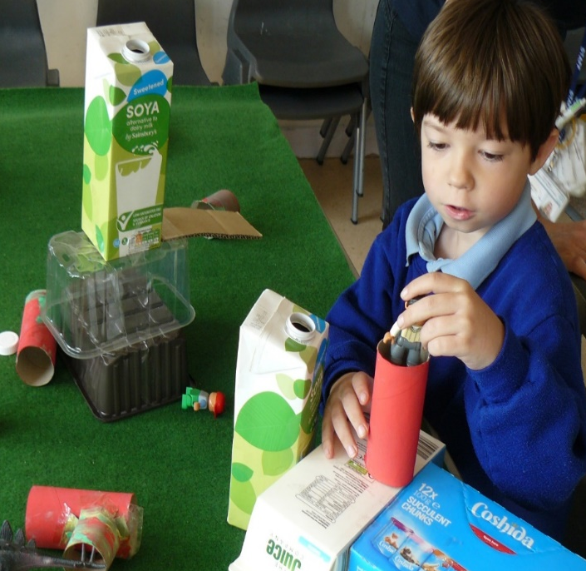
Playing and exploring:
I can interact purposefully with a toy/object/material
Active Learning:
I keep on trying !
Creating and thinking critically:
I combine and connect things during my play

Slide 8
Seven Areas Of Learning
Prime Areas: Communication and interaction underpin all that we do, alongside the other prime areas of the EYFS - Physical Development and Personal Social and Emotional Development.
The Specific areas include: Maths, Literacy, Understanding The World, Expressive Arts and Design
Delivery
The Prime and Specific Areas are delivered through a combination of teacher led sessions, linked provision, continuous provision and 1:1 sessions.

Slide 9
Communication and language Routine songs – Hello, transition songs Communication aids such as Big Mac, symbols and Makaton, PECS Visual Timetables Singing Stories and sensory stories Reading Area 1:1 sessions & SALT targets Intensive Interaction Tac Pac | Literacy and Maths Routine songs Visual Timetable Teacher led maths sessions x2 Teacher led Phonics - daily Reading Area Teacher led Story time and comprehension activities x1 Mark Making / Write Dance x1 Problem solving through play | Understanding The World Exploring the world around me through indoor and outdoor play Sand and water Sensory Play Theme based linked provision
Personal, Social, Emotional Development Routine Songs Regulation activities Choices encouraged Adult supported turn taking activities Promoting Self Help and Independence skills | Physical Development Physiotherapy programmes Rebound Therapy Swimming Mark Making Outdoor Play PE Music and Movement Threading and Fine Motor CP Food Preparation Physio Bods | Expressive Arts And Design Role Play and Dressing Up provision Music and Movement Singing Sensory Stories Theme Based linked provision

Slide 10
Child Centred Learning
The health care plan remains central throughout the curriculum
All children have needs that identified in their EHCP that can potentially be achieved in and THROUGH the curriculum. Four targets are identified each term and these are tracked through MAPP.
For example, during maths a pupil might be working on a target to be able to attend to a group session, as well as their lesson objective which could be to learn numbers 1-3.
CL
PSED
PD
M
The
Learner
EHCP
L
EAD
UW

Slide 11
EYFS and KS1 Curriculum
Arrival & registration/ Personal exploration and individual work Continuous Provision in the seven areas of learning Developing Characteristics Of Effective Learning Learning through Play | Communication and Hello Phonics | Literacy Story, Reading | PSED Lunch Time | Discovery Theme Play Activity stations: EYFS areas of Learning | Story/ Singing/ Reflection/ Reading
 |  | Swimming My Movement PSHE |  | Discovery Theme Play Activity stations: EYFS areas of Learning | Story/ Singing/ Reflection/ Reading
 |  | Maths Numbers, quantity, everyday objects |  | Discovery Theme Play Activity stations: EYFS areas of Learning | Story/ Singing/ Reflection/ Reading
 |  | Literacy Mark making, writing |  | Discovery Theme Play Activity stations: EYFS areas of Learning | Story/ Singing/ Reflection/ Reading
 |  | My Thinking Shape and Space |  | Discovery Theme Play Activity stations: EYFS areas of Learning | Story/ Singing/ Reflection/ Reading

Slide 12
EYFS and KS1 Curriculum
Arrival & registration/ Personal exploration and individual work Planned 1:1 sessions and learning through play (Developing characteristics of effective learning) | Communication and Hello | My Communication Story, Reading, phonics | PSED Lunch Time | Discovery Theme Play Activity stations: Prime areas of learning | Story/ Singing/ Reflection/ Reading
 |  | Swimming My Movement |  | Discovery Theme Play Activity stations: Prime areas of learning | Story/ Singing/ Reflection/ Reading
 |  | My Thinking Numbers, quantity, everyday objects |  | Discovery Theme Play Activity stations: Prime areas of learning | Story/ Singing/ Reflection/ Reading
 |  | My Communication Mark making, writing |  | Discovery Theme Play Activity stations: Prime areas of learning | Story/ Singing/ Reflection/ Reading
 |  | My Thinking Shape and Space |  | Discovery Theme Play Activity stations: Prime areas of learning | Story/ Singing/ Reflection/ Reading
EHCP Outcomes
Characteristics of Effective Learning
Enabling Environment

